Slide 1


2
Healthcare Data Mining
for Disease Prediction
3
CSA1606 — Data Warehousing and Data Mining
4
5
Faculty: Dr. S. Renuga
Professor/CSE
Presented by:
Amrita Arun Hima Harshitha

Slide 2
ABSTRACT
Healthcare data contains valuable information that can support early disease prediction.
Manual disease identification may require additional consultation time and may not provide immediate preliminary guidance.
The proposed system is a web-based clinical prediction platform that collects patient details and symptoms.
The input data is validated and preprocessed before prediction.
A trained Random Forest classification algorithm is used to predict a possible disease.
The system displays the predicted disease and confidence score.
It also provides general precautions and recommendations.
Prediction results are stored in a MySQL database for future reference

Slide 3
INTRODUCTION
Healthcare systems generate large amounts of patient and symptom-related data.
Data mining and machine learning can be used to identify useful patterns from healthcare data.
Disease prediction based on symptoms can provide preliminary guidance to users.
Traditional/manual disease identification can take additional time.
The proposed system uses Random Forest classification for symptom-based disease prediction.
A web interface makes the system simple and accessible.
Prediction results are stored in MySQL for maintaining prediction history.
Main Idea
Patient Symptoms → Data Preprocessing → Random Forest → Disease Prediction → Confidence + Recommendations → MySQL

Slide 4
EXISTING SYSTEM
Existing Approach
Disease identification is often dependent on consultation and manual assessment.
Patients may have limited access to preliminary guidance.
Manual identification can require additional time.
Some existing healthcare systems focus on appointment management rather than intelligent disease prediction.
Prediction quality can be affected when patient information or symptoms are incomplete or incorrect.
Limitations
Time-consuming manual processes.
Limited immediate preliminary guidance.
Lack of integrated machine learning prediction in some systems.
Difficulty handling large symptom-based datasets manually.
Dependence on accurate patient input.

Slide 5
PROPOSED SYSTEM
Develop a web-based AI-assisted disease prediction system.
Collect patient details and symptoms through a web interface.
Validate and preprocess the submitted information.
Convert symptoms into the required machine-learning format.
Use a trained Random Forest model for disease classification.
Generate a possible disease prediction with a confidence score.
Provide general precautions and recommendations.
Store prediction results securely in MySQL.
Proposed Advantage
Simple Input + Automated Processing + ML Prediction + Confidence + Recommendations + History

Slide 6
LITERATURE REVIEW
Title | Author | Year | Problem Solved | Advantages | Disadvantages
Disease Prediction Using ML Algorithms | Various | 2021 | Symptom-based disease prediction | Random Forest performed well | Sensitive to wrong inputs
Disease Prediction using Machine Learning | Panchal et al. | 2020 | Early disease identification | Uses Random Forest | Depends on input quality
Symptom-Based Disease Prediction: A ML Approach | Sirigineedi et al. | 2024 | Multi-symptom disease prediction | Multiple ML models + evaluation | Needs diverse datasets
Symptom Based Disease Prediction Using ML | Sood & Sharma | 2024 | Rapid preliminary prediction | RF, KNN, DT, NB comparison | Dataset dependent
Optimized ML Classifiers for Symptom-Based Disease Screening | Research study | 2024 | Automated disease screening | Robust classifier comparison | Needs real-world validation

Slide 7
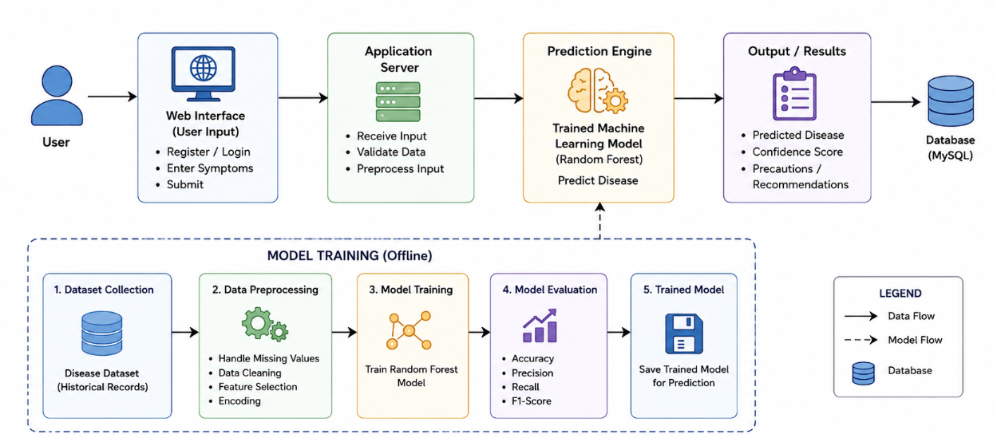
SYSTEM ARCHITECTURE

Slide 8
MODULE 1 — WEB INTERFACE
the Web Interface/User Input module.
Objectives
Provide a simple user-friendly interface.
Collect patient information.
Collect symptoms required for prediction.
Send the submitted information to the application server.
Display the prediction result to the user.
Components
Patient details form
Symptom selection interface
Submit button
Login/registration interface
Result display interface
Frontend HTML/CSS/JavaScript
Working
User → Enters Patient Details → Selects Symptoms → Submits Form → Data Sent to Application Server
Output
Valid patient information.
Selected symptoms.
Submitted prediction request.
Prediction result displayed to the user.

Slide 9
MODULE 2 — APPLICATION SERVER
the bridge between the user interface and machine-learning model.
Objectives
Receive patient information from the web interface.
Validate user input.
Process submitted symptoms.
Convert symptoms into the required format.
Forward processed data to the prediction engine.
Components
Flask/Python application server
Input validation
Data preprocessing
Symptom encoding
Backend communication
ML model interface
Working
Web Input → Validation → Symptom Processing → Feature Conversion → Prediction Engine
Output
Validated patient data.
Preprocessed symptom features.
ML-ready input sent to the prediction engine.

Slide 10
MODULE 3 — PREDICTION ENGINE & OUTPUT
The machine-learning prediction and result-presentation component.
Objectives
Predict the possible disease from processed symptoms.
Calculate the prediction confidence.
Present the prediction clearly.
Provide precautions and recommendations.
Store the prediction result in MySQL.
Components
Trained Random Forest model
Prediction function
Confidence calculation
Recommendation module
Result interface
MySQL database
Working
Processed Symptoms → Random Forest → Disease Prediction → Confidence → Recommendations → MySQL
Output
Predicted disease.
Confidence score.
General precautions.
Recommendations.
Stored prediction history

Slide 11
OFFLINE MODEL TRAINING
Objectives
Prepare historical disease data for machine learning.
Train the Random Forest classifier.
Evaluate model performance.
Save the trained model for future predictions.
Components
Historical disease dataset
Data preprocessing
Feature preparation
Random Forest classifier
Evaluation metrics
Saved trained model
Working
Dataset → Cleaning → Preprocessing → Training → Evaluation → Model Saving
Output
Trained Random Forest model.
Evaluated model performance.
Saved model used by the Prediction Engine

Slide 12
Results
Patient details and symptoms can be collected through the web interface.
Submitted information is validated and preprocessed.
The trained Random Forest model generates a possible disease prediction.
A confidence score is displayed with the prediction.
General precautions and recommendations are provided.
Prediction results are stored in MySQL.
Previous prediction information can be maintained for future reference.

Slide 13
CONCLUSION
The proposed system provides a simple web-based platform for symptom-based disease prediction.
Patient information is validated and preprocessed before prediction.
Random Forest is used as the disease classification algorithm.
The system provides a possible disease along with a confidence score.
General precautions and recommendations are presented to the user.
Prediction information is stored in MySQL.
The system demonstrates the application of Data Mining and Machine Learning in healthcare.

Slide 14
FUTURE SCOPE
Hospital API Integration
Connect the system with real hospital information systems.
Live Doctor Availability
Provide information about available doctors and appointments.
AI Healthcare Chatbot
Provide interactive real-time assistance.
Video Consultation
Enable users to connect with healthcare professionals remotely.
Cloud Database Deployment
Support scalable healthcare data storage.

Slide 15


